Slide 1
Analyzing the Impact of Car Features on Price and Profitability
-Vivek Kushwaha

Slide 2
PROJECT DESCRIPTION:
The automotive industry has been rapidly evolving over the past few decades, with a growing focus on fuel efficiency, environmental sustainability, and technological innovation. With increasing competition among manufacturers and a changing consumer landscape, it has become more important than ever to understand the factors that drive consumer demand for cars.
In recent years, there has been a growing trend towards electric and hybrid vehicles and increased interest in alternative fuel sources such as hydrogen and natural gas. At the same time, traditional gasoline-powered cars remain dominant in the market, with varying fuel types and grades available to consumers.
For the given dataset, as a Data Analyst, the client has asked How can a car manufacturer optimize pricing and product development decisions to maximize profitability while meeting consumer demand?
This problem could be approached by analyzing the relationship between a car's features, market category, and pricing, and identifying which features and categories are most popular among consumers and most profitable for the manufacturer. By using data analysis techniques such as regression analysis and market segmentation, the manufacturer could develop a pricing strategy that balances consumer demand with profitability, and identify which product features to focus on in future product development efforts. This could help the manufacturer improve its competitiveness in the market and increase its profitability over time.

Slide 3
Dataset Description: "Car Features and MSRP"
Number of observations: 11,159
Number of variables: 16
File type: CSV (Comma Separated Values)
COLUMN
Make: the make or brand of the car
Model: the specific model of the car
Year: the year the car was released
Engine Fuel Type: the type of fuel used by the car (gasoline, diesel, etc.)
Engine HP: the horsepower of the car's engine
Engine Cylinders: the number of cylinders in the car's engine
Transmission Type: the type of transmission (automatic or manual)
Driven_Wheels: the type of wheels driven by the car (front, rear, all)
Number of Doors: the number of doors the car has
Market Category: the market category the car belongs to (Luxury, Performance, etc.)
Vehicle Size: the size of the car
Vehicle Style: the style of the car (Sedan, Coupe, etc.)
Highway MPG: the estimated miles per gallon the car gets on the highway
City MPG: the estimated miles per gallon the car gets in the city
Popularity: a ranking of the popularity of the car (based on the number of times it has been viewed on Edmunds.com)
MSRP: the manufacturer's suggested retail price of the car.

Slide 4
TECH-STACK USED:
MS Excel 2019 for Data Analysis.
MS PowerPoint for Presentation.
Formula Functionality: Excel provides a wide range of built-in functions and formulas that allow users to perform complex calculations and automate tasks. These functions enable users to manipulate and analyze data efficiently.

Slide 5
APPROACH:
Data Cleaning: Removing duplicates, Null Values, etc.
Understanding the relationships of columns.
Performing descriptive analysis for the given tasks.
Plotting the required graphs.
Established and generated Insights through Data Analysis.

Slide 6
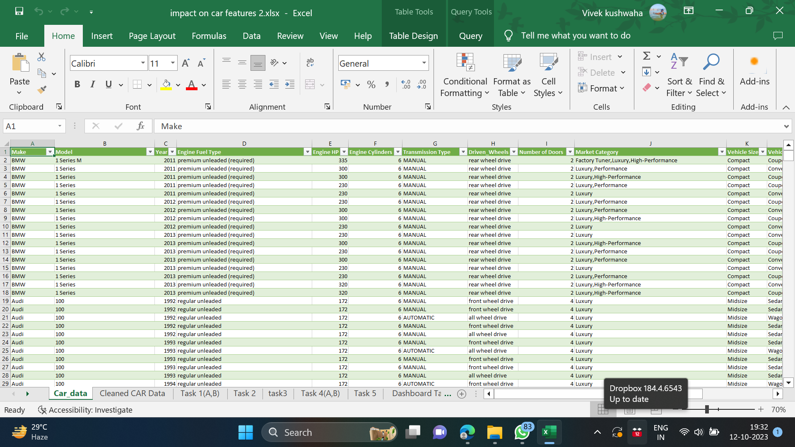
Data Cleaning: Raw Data-

Slide 7
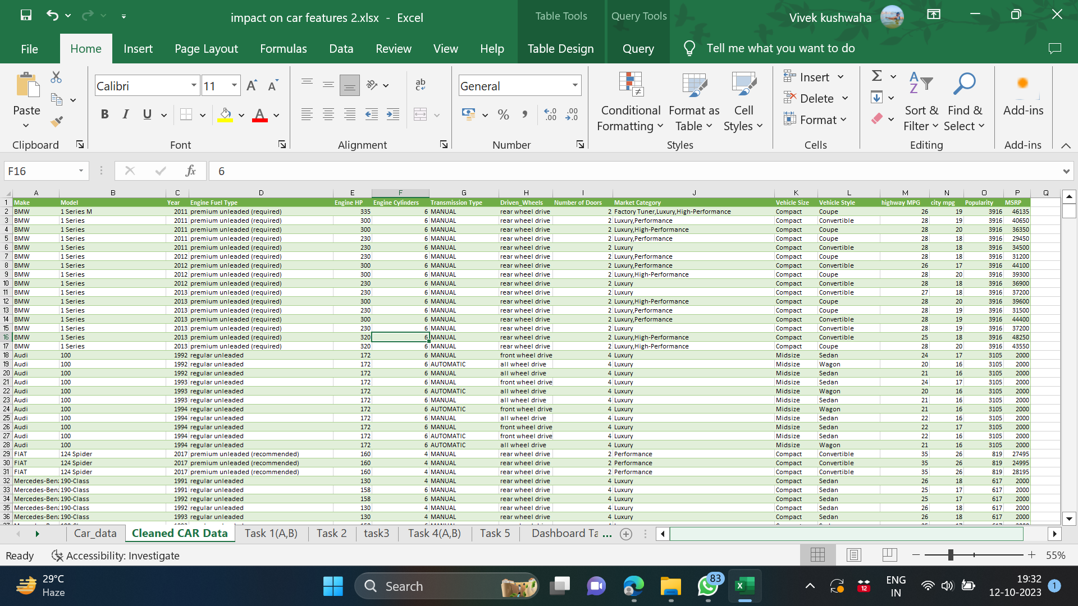
Cleaned Data

Slide 8
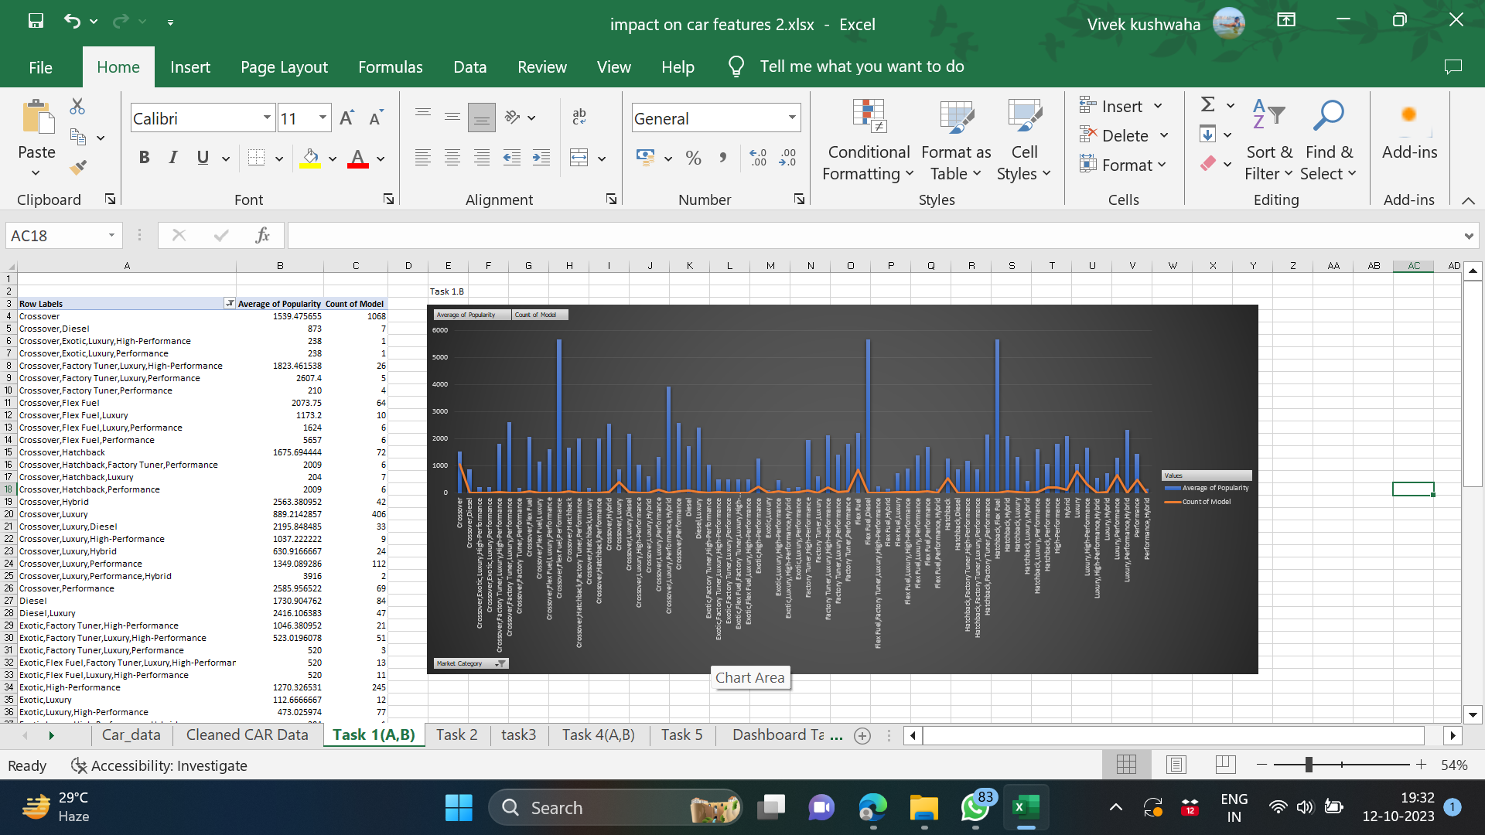
TASK (1) Insight Required: How does the popularity of a car model vary across different market categories?
Create a pivot table that shows the number of car models in each market category and their corresponding popularity scores.

Slide 9
(B) Create a combo chart that visualizes the relationship between market category and popularity.

Slide 10
Desired Insight:
Market Categories that are most popular:
Hatchback vehicles with Flex fuel
Diesel vehicles with flex fuel
Performance, Crossover, and Flex Fuel vehicle
Market Categories that are not popular:
Luxury
Exotic

Slide 11
Task 2 Insight Required: What is the relationship between a car's engine power and its price?
Create a scatter chart that plots engine power on the x-axis and price on the y-axis. Add a trendline to the chart to visualize the relationship between these variables.
Desired Insight:
There is a presence of very strong linear relationship.
With respect to linear trendline we can eventually notice with the increase in Horsepower of the engine, there is an increase in the Price.

Slide 12
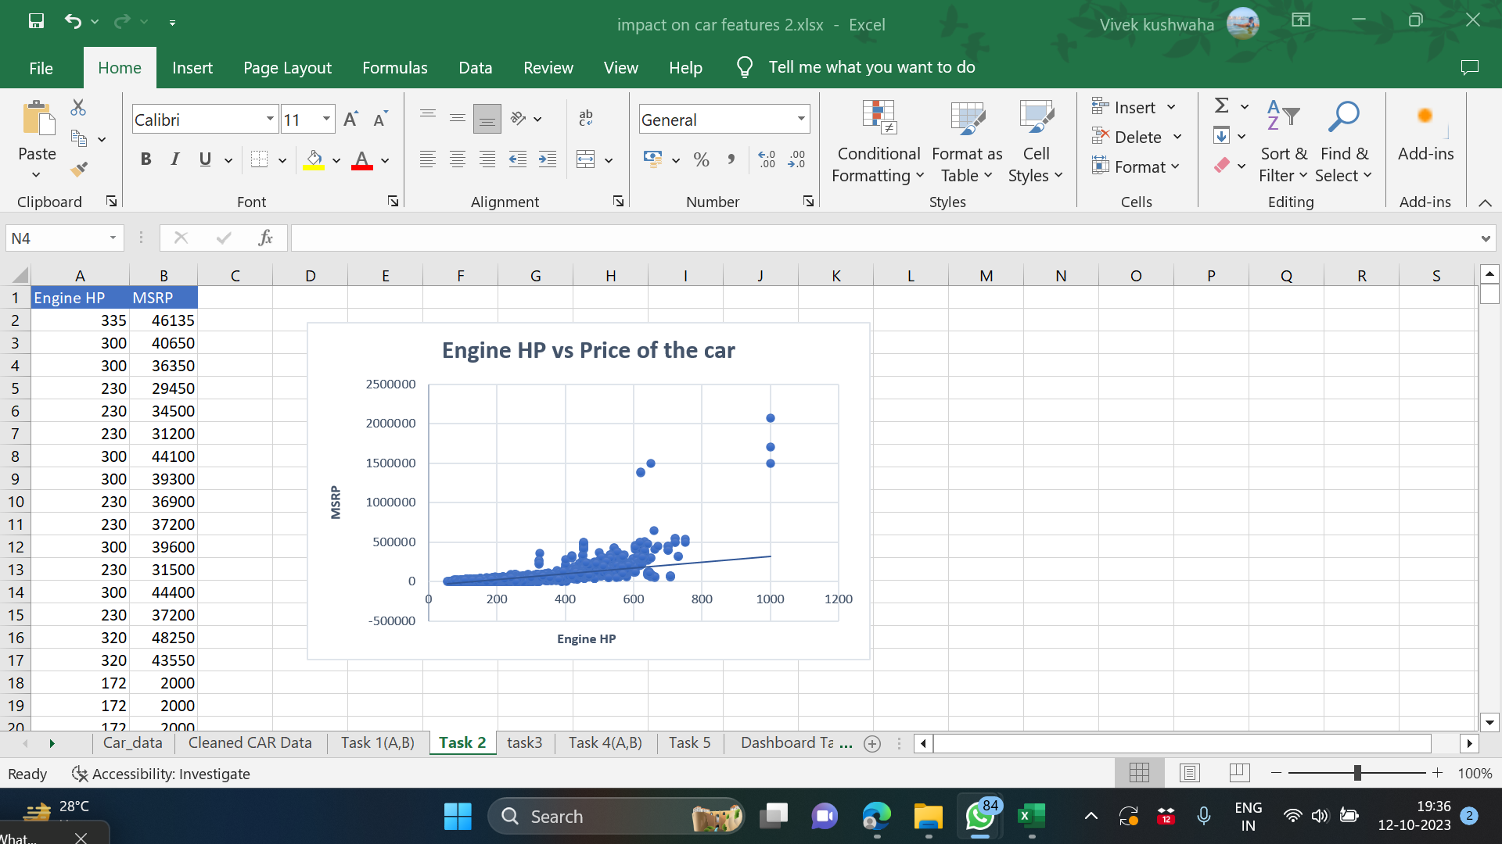

Slide 13
Task 3 Insight Required: Which car features are most important in determining a car's price?
Use regression analysis to identify the variables that have the strongest relationship with a car's price. Then create a bar chart that shows the coefficient values for each variable to visualize their relative importance.
Desired Insight:
The positive regression coefficient of engine cylinders shows that increasing the number of engine cylinders will lead to an automatic increase in the price of the car.
The negative correlation signifies that when one of these variables increases, the others tend to decrease. There is a negative correlation between the MSRP and the variables of highway mileage, city MPG, and the number of doors.

Slide 14
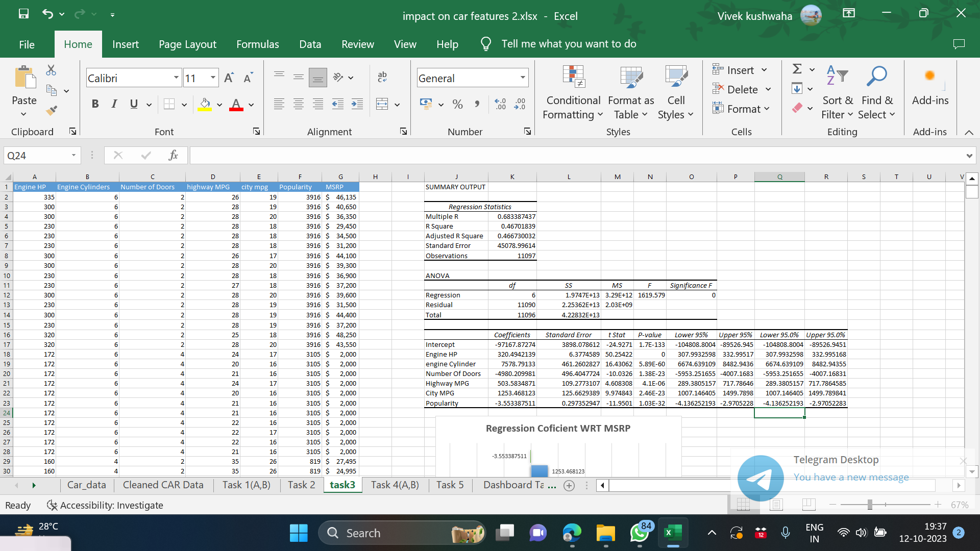

Slide 15
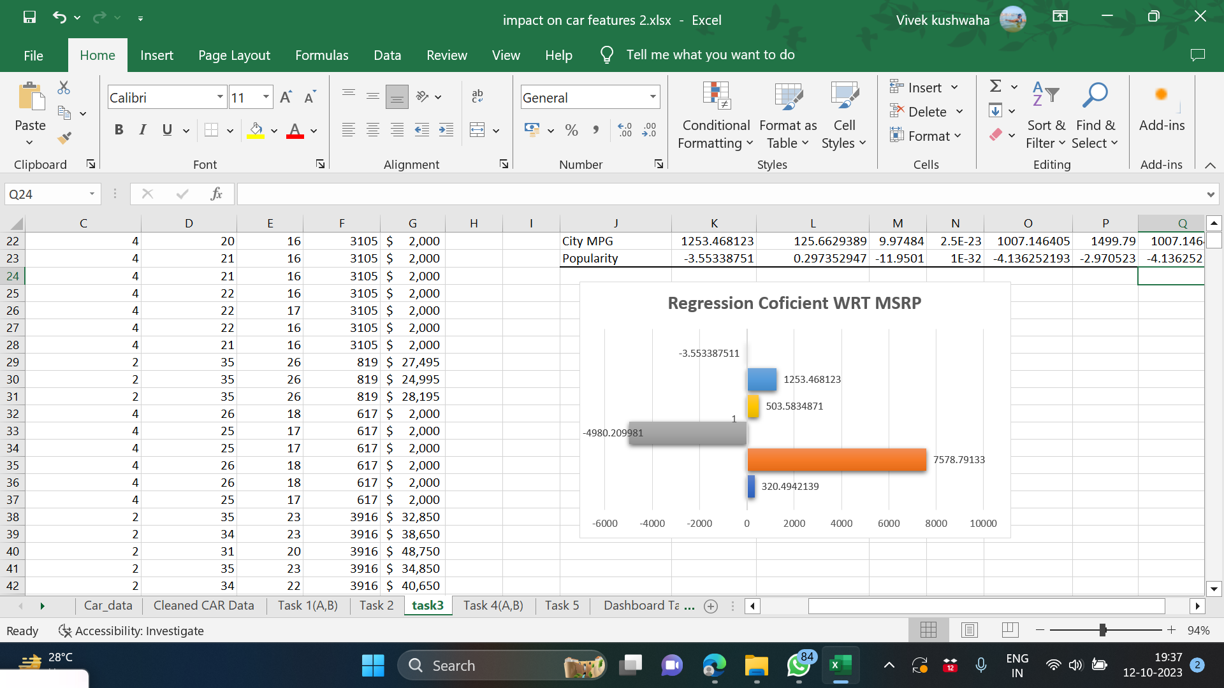
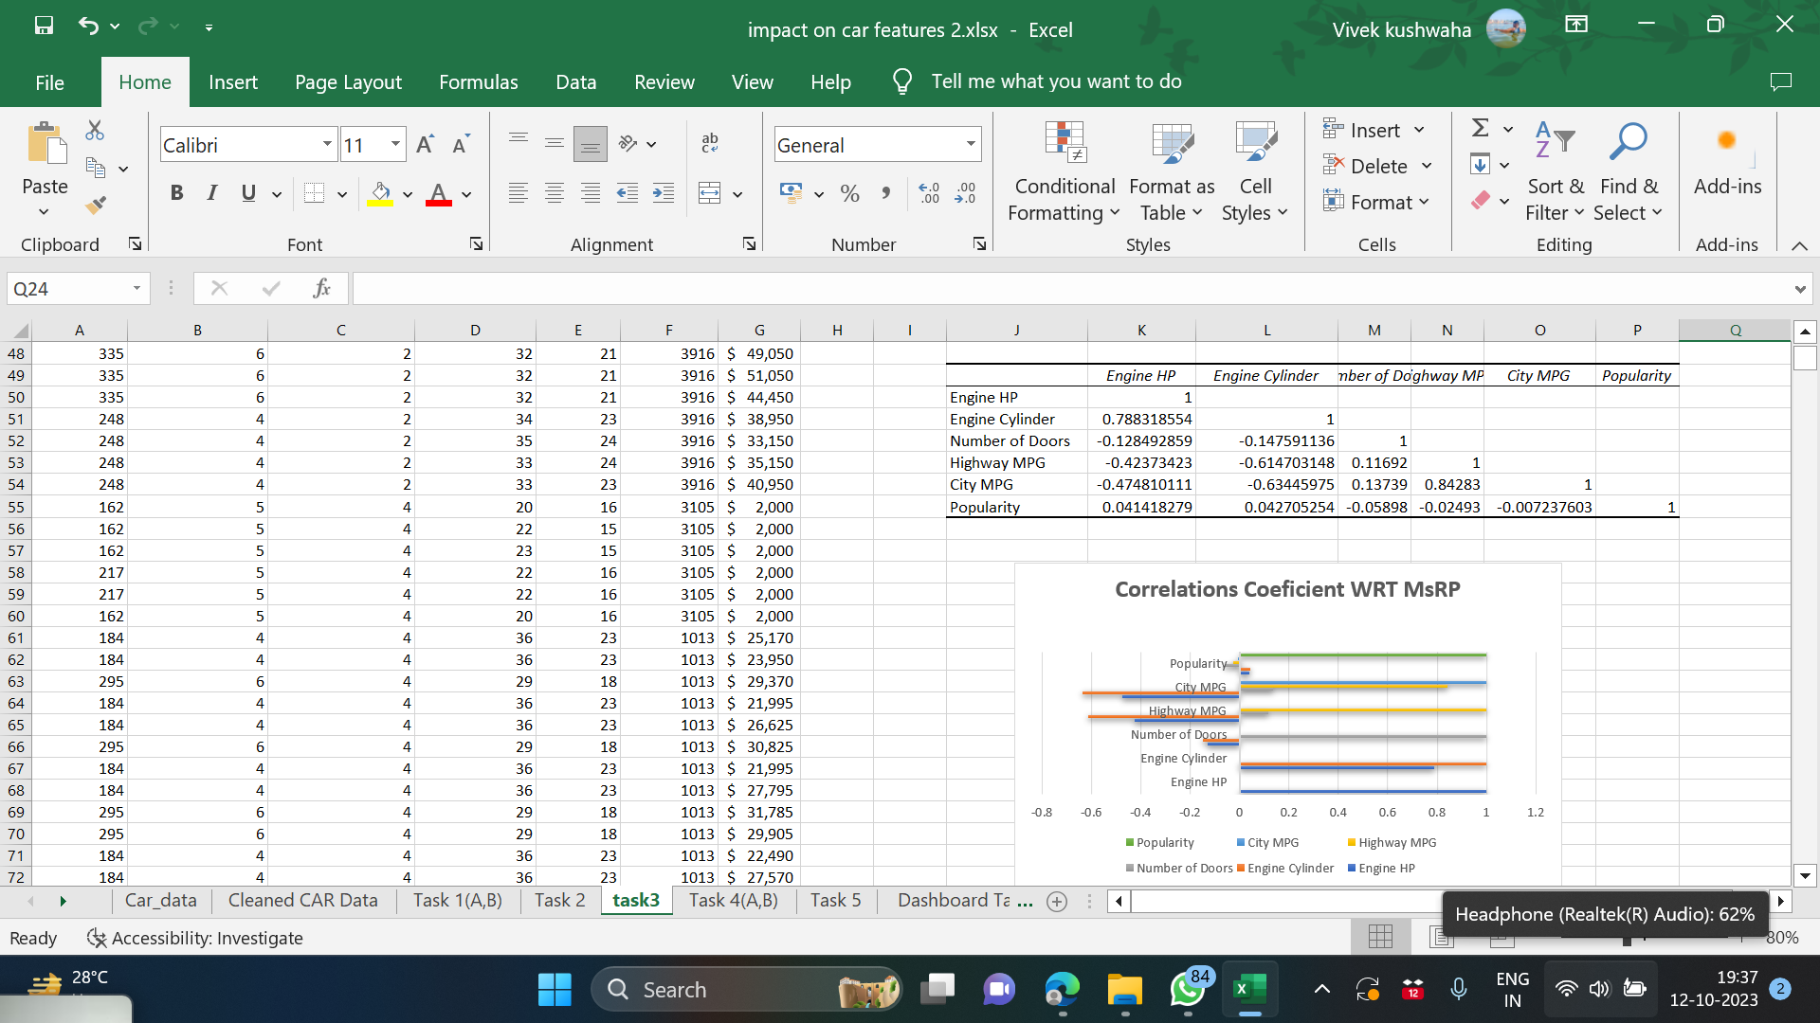
Regression And Correlation WRT MSRP

Slide 16
Task 4 Insight Required: How does the average price of a car vary across different manufacturers?
Create a pivot table that shows the average price of cars for each manufacturer.
Create a bar chart or a horizontal stacked bar chart that visualizes the relationship between manufacturer and average price.
Desired Insight:
According to the graph, the manufacturer "Bugatti" has the highest average price, followed by "Maybach," "Rolls-Royce," and "Lamborghini."
“Plymouth” has the lowest average price.
Bugatti | 1757223.667
Maybach | 546221.875
Rolls-Royce | 351130.6452
Suzuki | 18021.0531
Oldsmobile | 12843.79545
Plymouth | 3296.873239

Slide 17
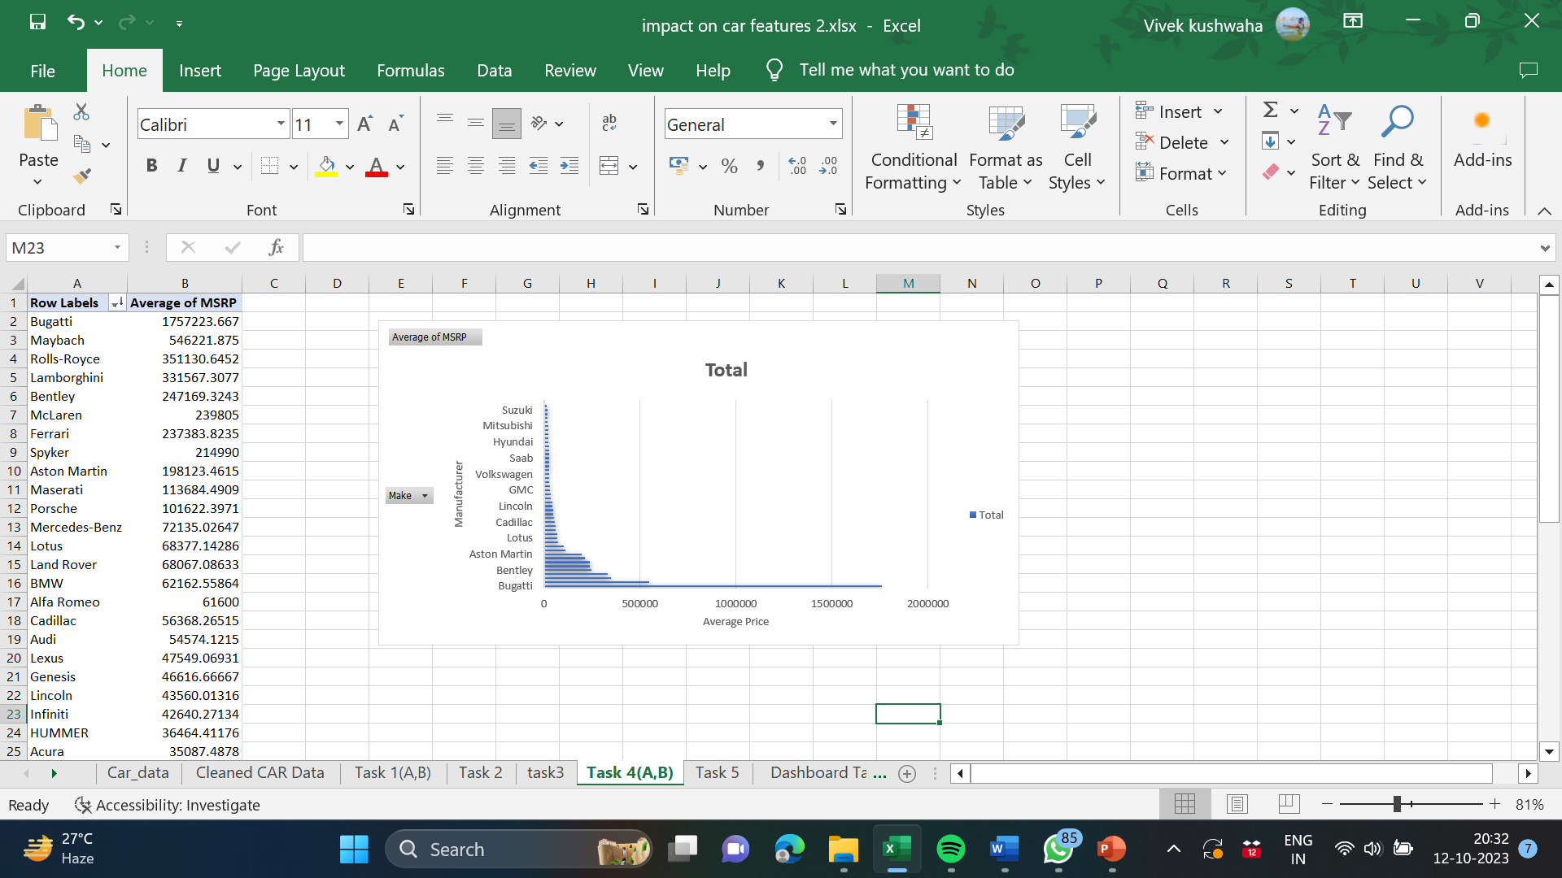

Slide 18
Task 5 Insight Required: What is the relationship between fuel efficiency and the number of cylinders in a car's engine?
(A)Create a scatter plot with the number of cylinders on the x-axis and highway MPG on the y-axis. Then create a trendline on the scatter plot to visually estimate the slope of the relationship and assess its significance.
(B) Calculate the correlation coefficient between the number of cylinders and highway MPG to quantify the strength and direction of the relationship.
Desired Insight
Negative trendline that states there is a negation relation between the number of cylinders and fuel efficiency, which means decrease in number of cylinders increases the fuel efficiency.
The correlation coefficient turns out to be negative.
Correlation Coefficient Between Engine Cylinders and Highway MPG
-0.613056488

Slide 19
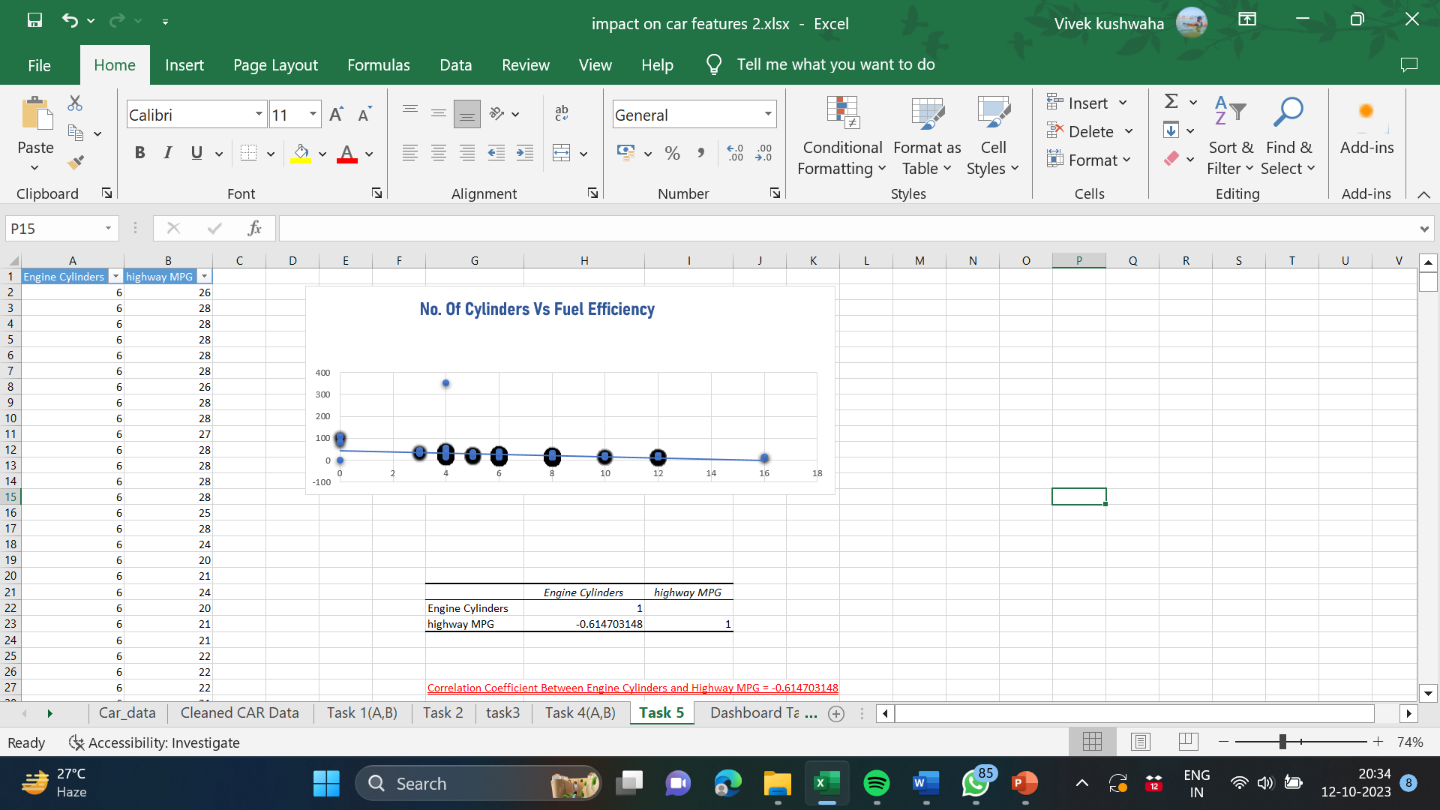

Slide 20
Building the Dashboard:
Now for the Next portion of the Project,
We need to create the Interactive Dashboard. Use filters and slicers to make the chart interactive. The client has requested these questions given below:

Slide 21
Task 1:
Task:
How does the distribution of car prices vary by brand and body style?
Stacked column chart to show the distribution of car prices by brand and body style.
Calculate the total MSRP for each brand and body style using SUMIF or Pivot Tables.

Slide 22
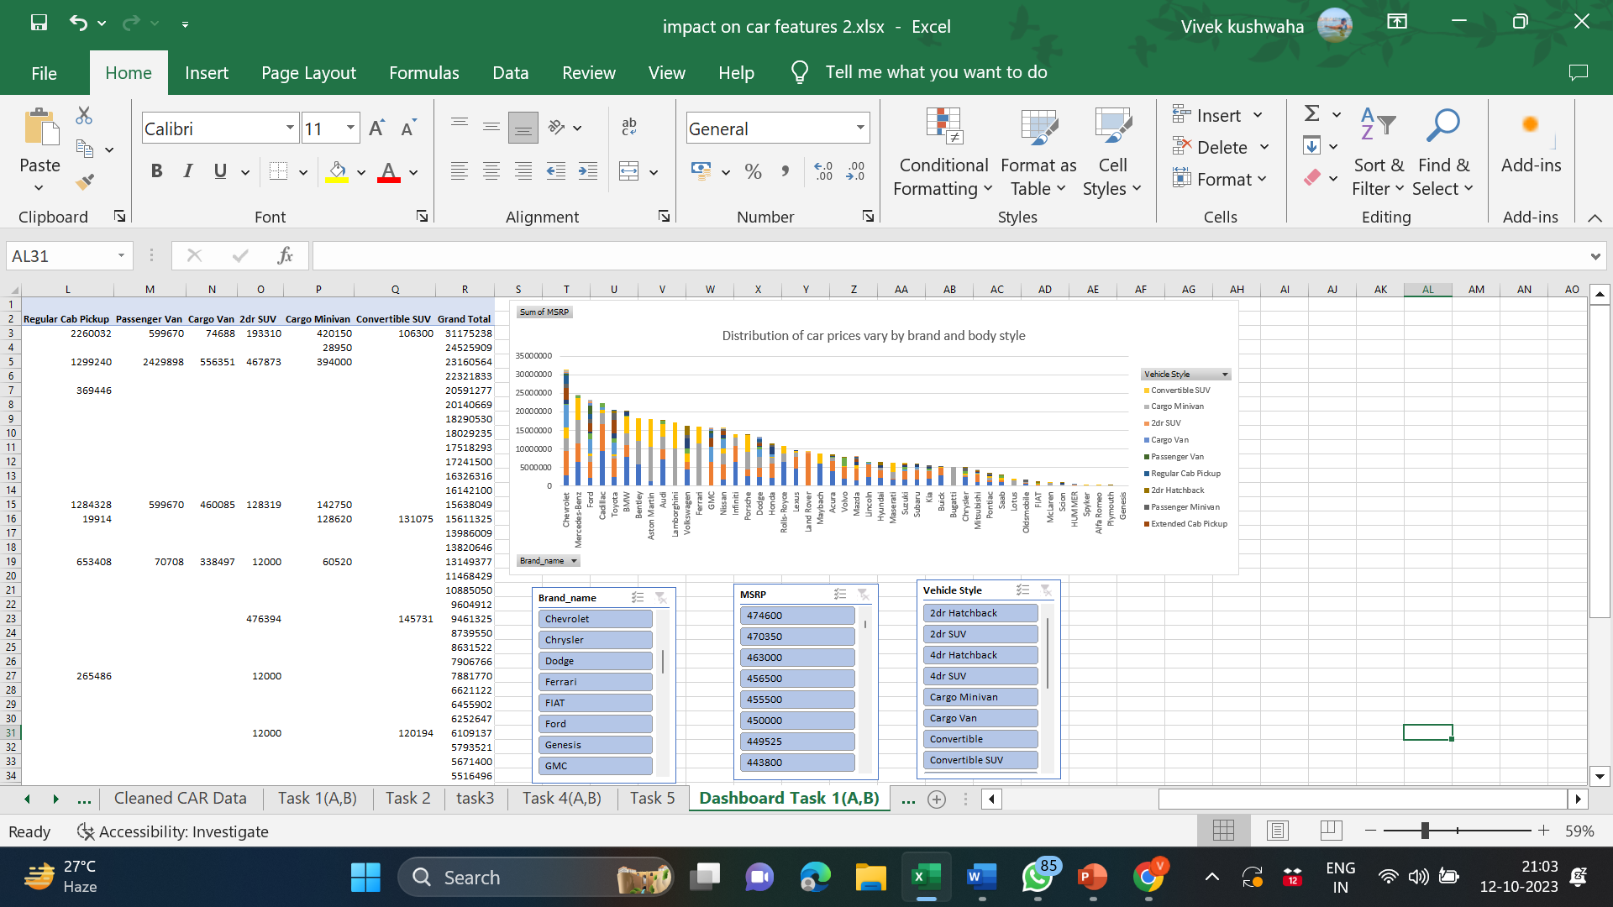

Slide 23
Insights:
According to Dashboard Analysis:
The Chart reveals that “Chevrolet” holds the highest Maximum Selling Retail Price(MSRP) among all manufacturer , followed by “Mercedes Benz” in the second position.
Among various vehicle styles , the “SEDAN” Category has the highest MSRP.

Slide 24
Task 2:
Task 2:
Which car brands have the highest and lowest average MSRPs, and how does this vary by body style?
And
Clustered column chart to compare the average MSRPs across different car brands and body styles.
Calculate the average MSRP for each brand and body style using AVERAGEIF or Pivot Tables.

Slide 25
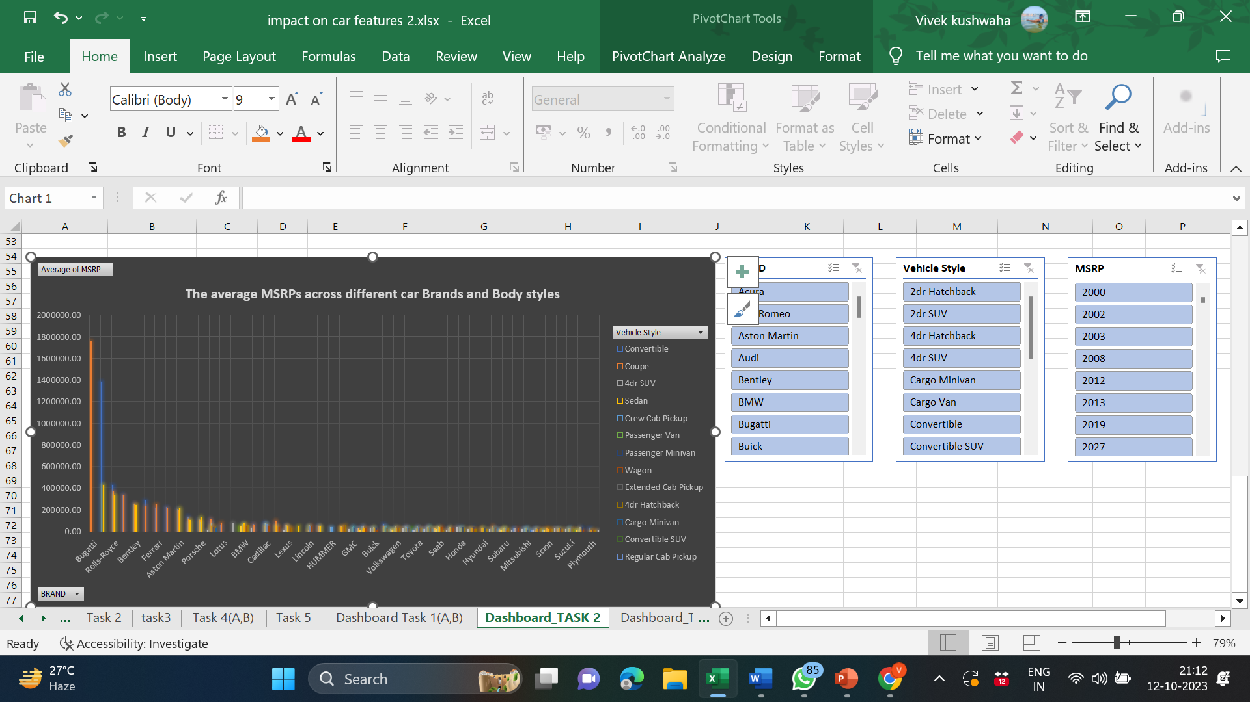

Slide 26
Insights:
According to the Dashboard analysis:
1.“Bugatti” has the highest price tag among automobile brands mentioned in the dashboard , while “Coupe” is the most favoured design.
2.“Maybach” has second rank in terms of Brand Popularity , followed by “Convertible” as the 2nd most preferred vehicle style .
3.“Playmouth” offers the lowest sticker price for its coupe , wagon , 4dr hatchback ,2dr hatchback models.

Slide 27
Task 3:
Task:
How do the different feature such as transmission type affect the MSRP, and how does this vary by body style?
Scatter plot chart to visualize the relationship between MSRP and transmission type, with different symbols for each body style.
Calculate the average MSRP for each combination of transmission type and body style using AVERAGEIFS or Pivot Tables.

Slide 28
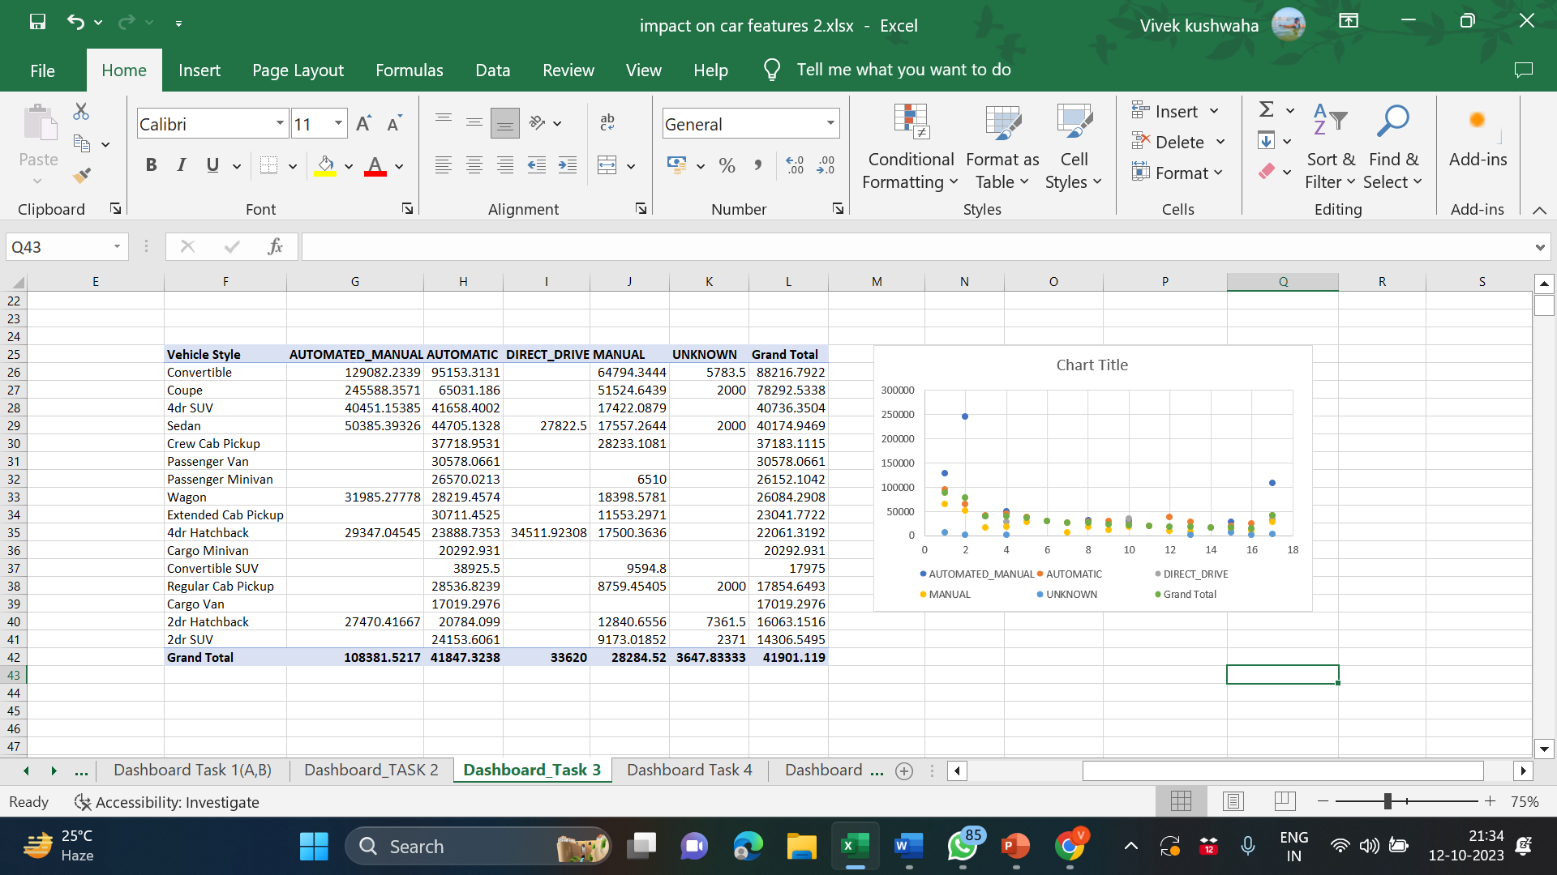

Slide 29
Insights:
According to the Dashboard analysis:
1. Mostly used transmission type is “Automated_manaul” i.e used in most of vehicle style.
2. Highest Avg MSRP of Vehicle style i.e “Convertible(82216.79)” by considering the average msrp for all transmission type.
3. Lowest Avg MSRP of Vehicle style i.e “2dr SUV(14306.54)” by considering the average msrp for all transmission type.

Slide 30
Task 4:
Task:
How does the fuel efficiency of cars vary across different body styles and model years?
Line chart to show the trend of fuel efficiency (MPG) over time for each body style.
Calculate the average MPG for each combination of body style and model year using AVERAGEIFS or Pivot Tables.

Slide 31
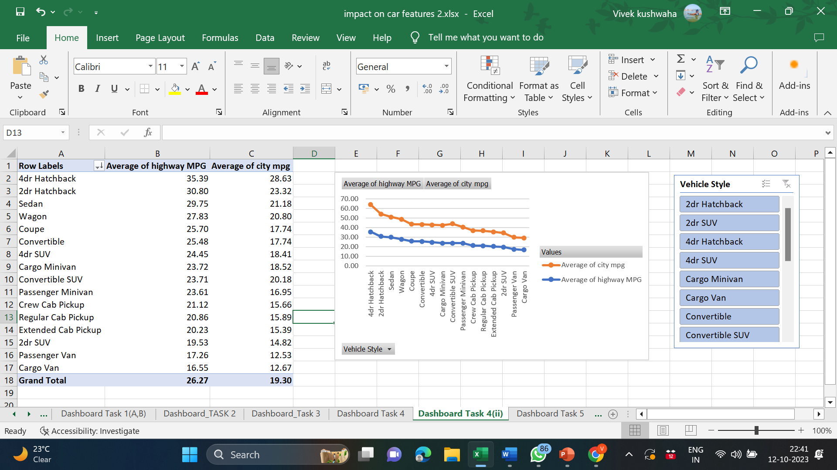
Fuel efficiency of cars vary across different body styles:

Slide 32
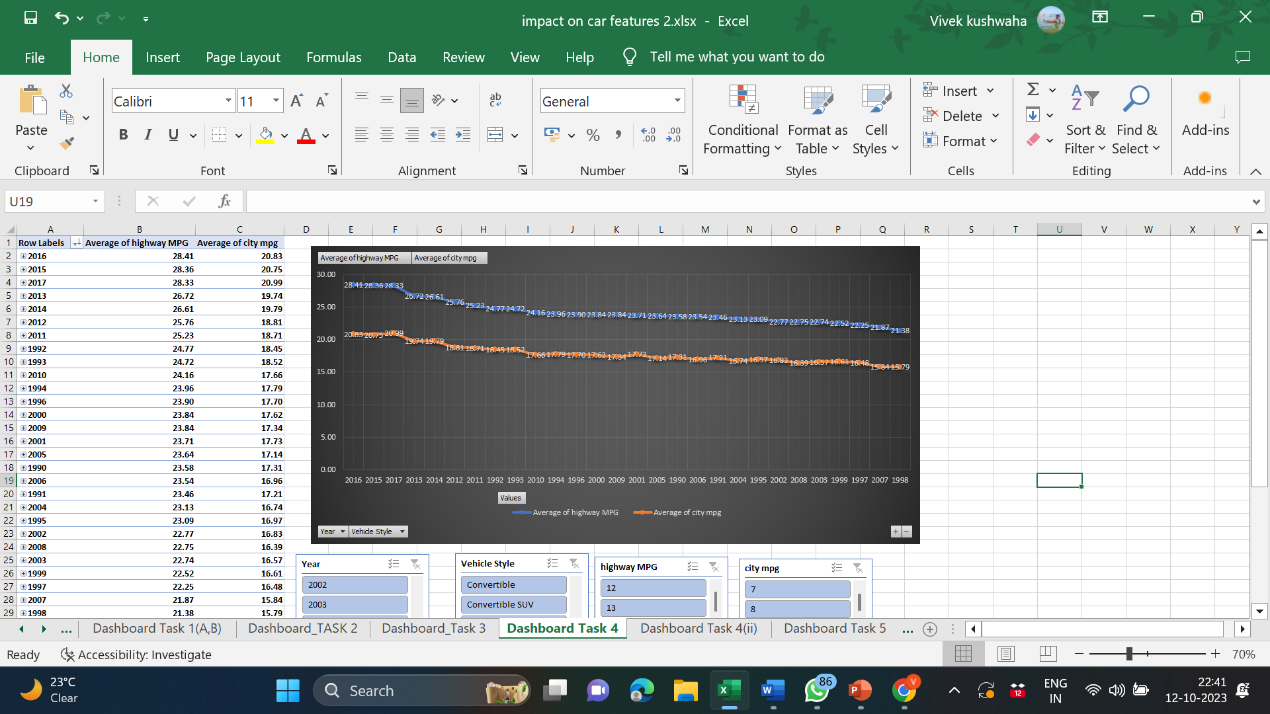
Fuel efficiency of cars vary across model year:

Slide 33
Insights:
According to the Dashboard analysis:
Fuel efficiency of cars vary across different body styles:
Body style 4dr hatchback has the highest MPG in both Highway MPG and City MPG.
Fuel efficiency of cars vary across different Model year:
In year 2016 Average of MPG is the highest for 4dr hatchback i.e 28.41,20.83 for
Highway MPG and City MPG respectively.

Slide 34
Task 5:
Task:
How does the car's horsepower, MPG, and price vary across different Brands?
Bubble chart to visualize the relationship between horsepower, MPG, and price across different car brands.
Assign different colors to each brand and label the bubbles with the car model name.
Calculate the average horsepower, MPG, and MSRP for each car brand using AVERAGEIFS or Pivot Tables.

Slide 35
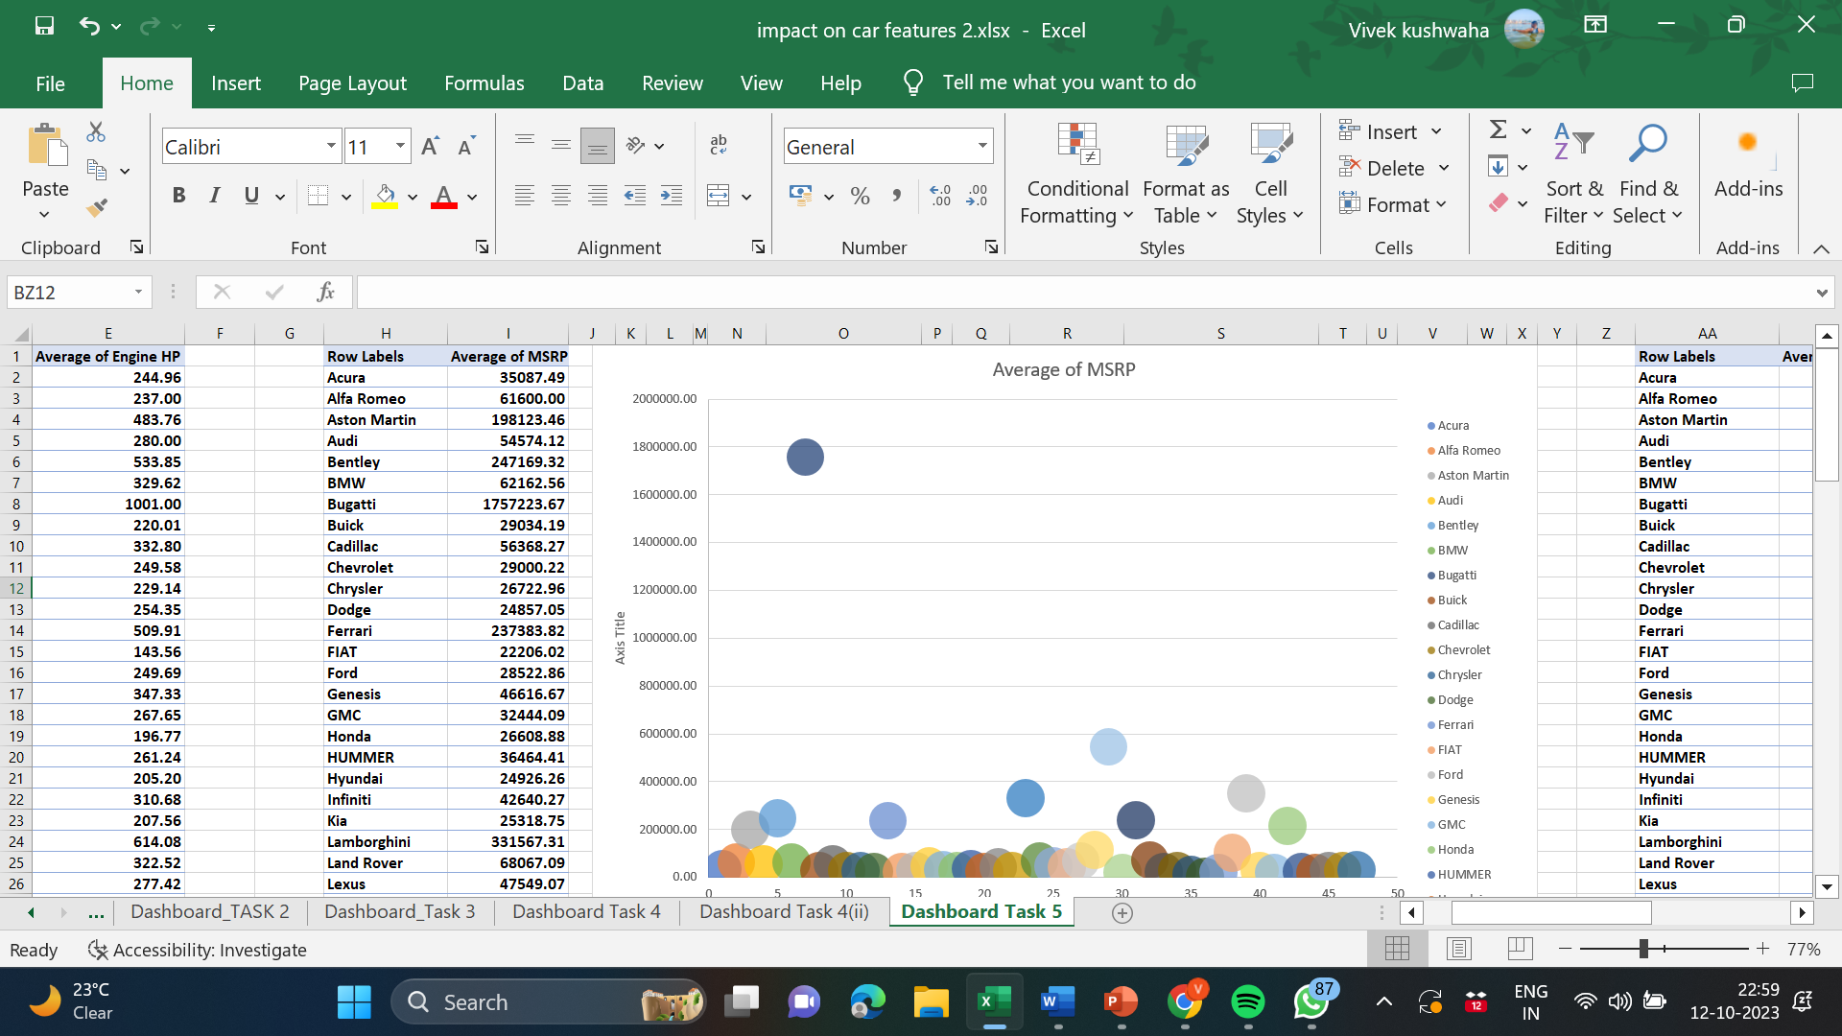
Average of MSRP

Slide 36
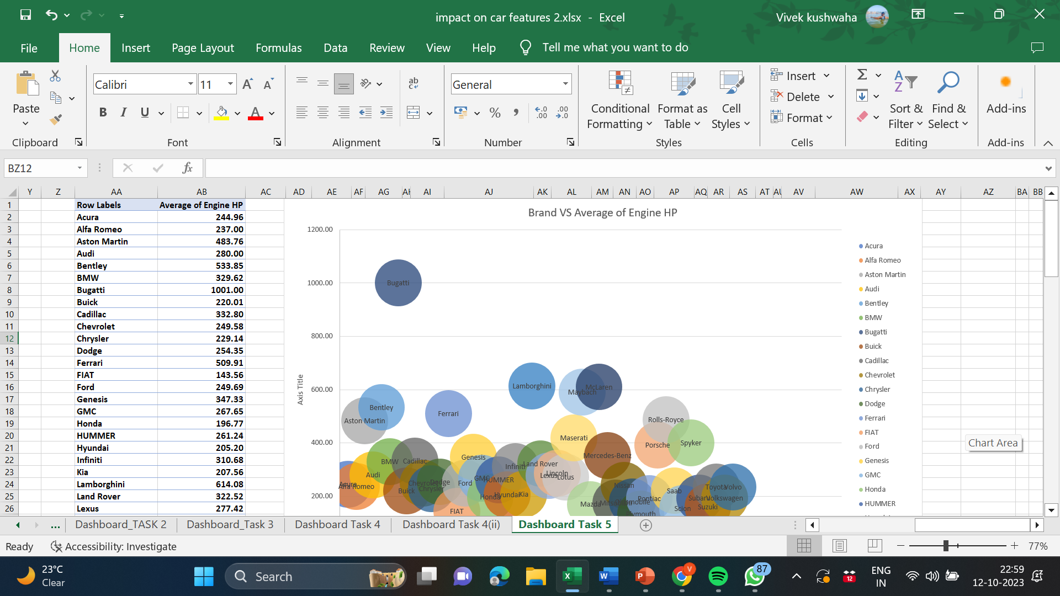
Brand vs Average of Engine HP

Slide 37
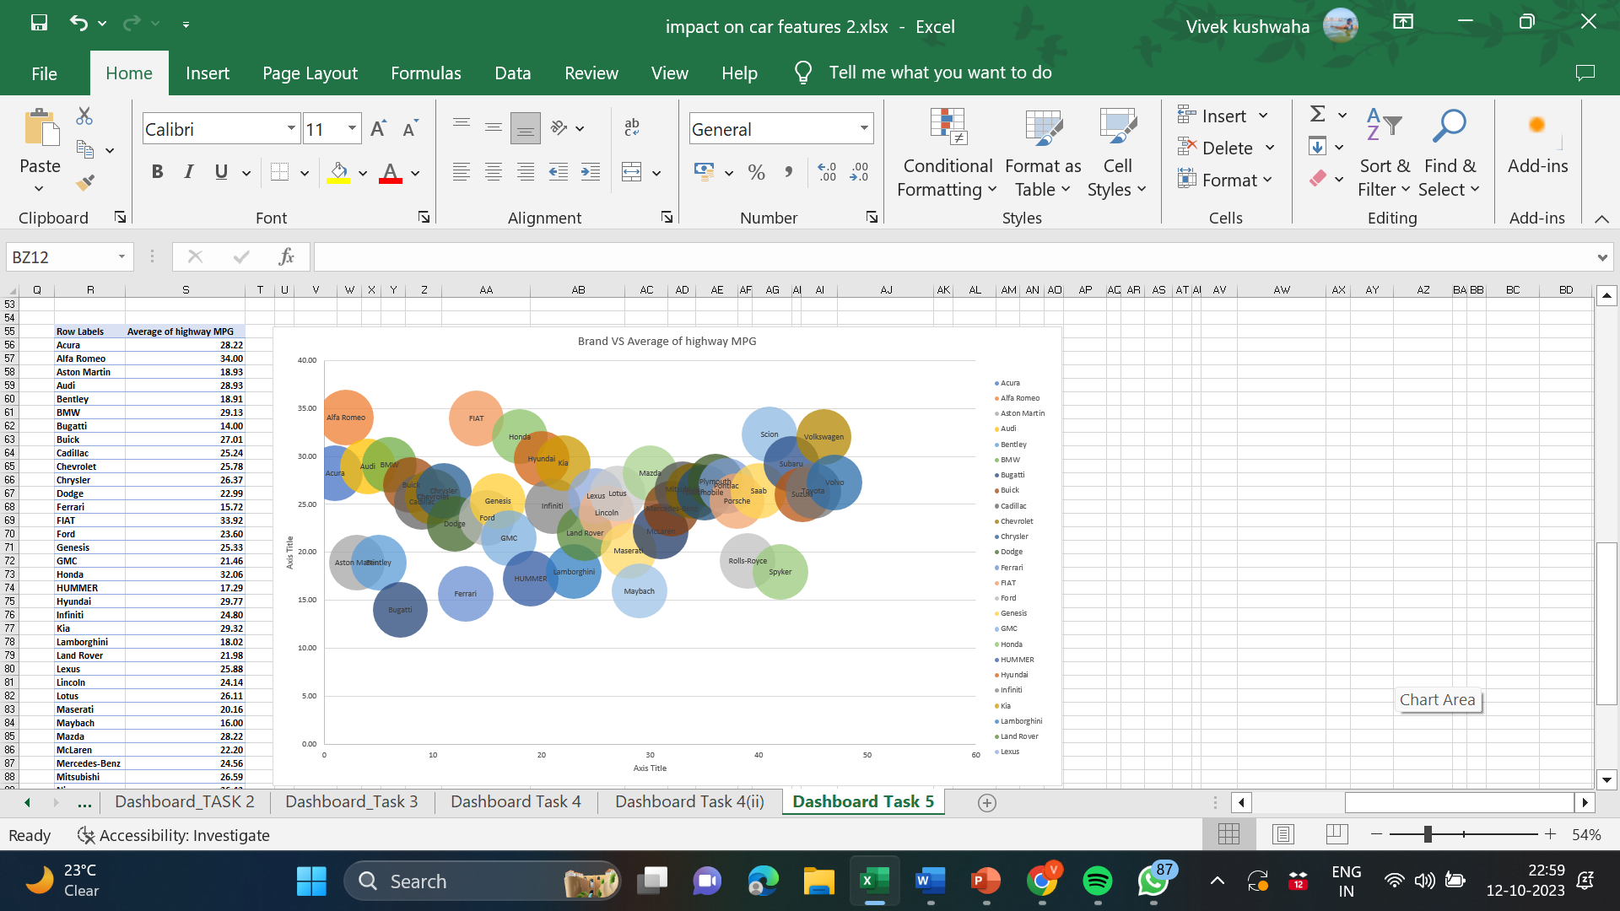
Brand vs Avg Of Highway MPG

Slide 38
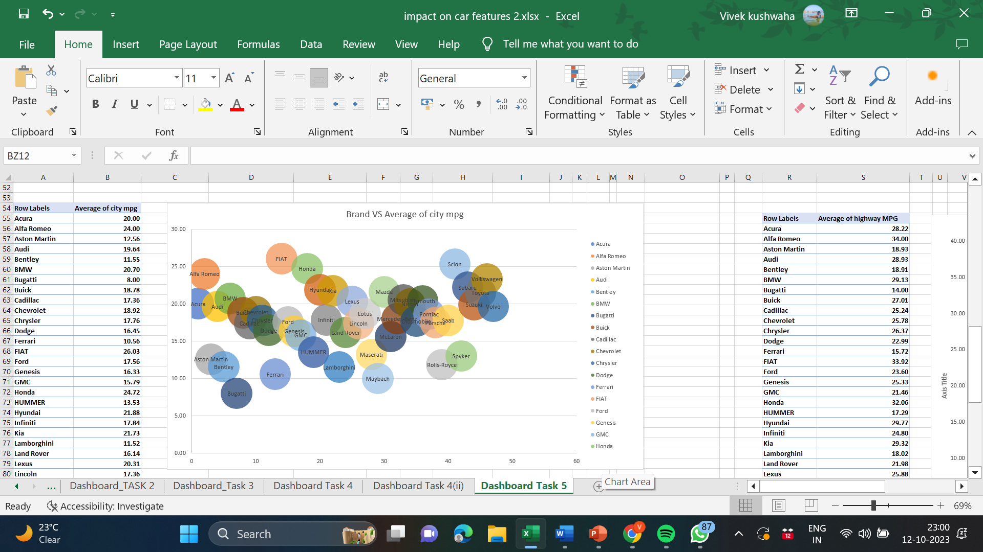
Brand vs Avg Of City MPG

Slide 39
Calculation of the average horsepower, MPG, and MSRP for each car brand using AVERAGEIFS or Pivot Tables:
Row Labels | Average of MSRP | Average of city mpg | Average of highway MPG | Average of Engine HP
Bugatti | 1757223.67 | 8.00 | 14.00 | 1001.00
Maybach | 546221.88 | 10.00 | 16.00 | 590.50
Rolls-Royce | 351130.65 | 11.84 | 19.13 | 487.55
Lamborghini | 331567.31 | 11.52 | 18.02 | 614.08
Bentley | 247169.32 | 11.55 | 18.91 | 533.85
McLaren | 239805.00 | 15.60 | 22.20 | 610.40
Ferrari | 237383.82 | 10.56 | 15.72 | 509.91
Spyker | 214990.00 | 13.00 | 18.00 | 400.00
Aston Martin | 198123.46 | 12.56 | 18.93 | 483.76
Maserati | 113684.49 | 13.20 | 20.16 | 419.55
Porsche | 101622.40 | 17.47 | 25.37 | 392.79
Mercedes-Benz | 72135.03 | 18.01 | 24.56 | 353.50
Lotus | 68377.14 | 18.68 | 26.11 | 271.54
Land Rover | 68067.09 | 16.14 | 21.98 | 322.52
BMW | 62162.56 | 20.70 | 29.13 | 329.62
Alfa Romeo | 61600.00 | 24.00 | 34.00 | 237.00
Here are the average of Engine HP,MPG,MSRP for some brands.. For all brands go through the EXCEL Sheet.

Slide 40
Link to Excek workbook
https://docs.google.com/spreadsheets/d/17h0XF6kiaG25wgmyfUPDI0JcnY3xgbRE/edit?usp=drive_link&ouid=107522417124927572865&rtpof=true&sd=true

Slide 41
Thank You…☺☺

